Slide 1


Breaking Down Your
Website Quality Assessment
PREPARED FOR
CIBTvisas
July 2024

Slide 2


What’s in this document?
1
What “website quality” is and why it’s important.
2
What inputs go into the report and how we analyze them.
The outputs of the report and how we use them to execute your campaign.
3

Slide 3
What is “Website Quality”?
Search engines send traffic to websites they deem as “high quality”. That means a few things:
Sites that are coded and structured according to their webmaster guidelines.
Sites that are “popular”, i.e. getting mentioned across the web.
Sites that satisfy “searcher intent” through relevant and quality content.
Having low quality pages, content, poor structure and lack of web mentions causes Google to lose trust in your website and crawl, index and rank it less and less over time.
We assess quality of your website by looking at a number of different data inputs, including inbound links, titles, content depth, sales from organic traffic, keyword rankings and more.
Additional resources:
Google’s Quality Score (Moz)

Slide 4

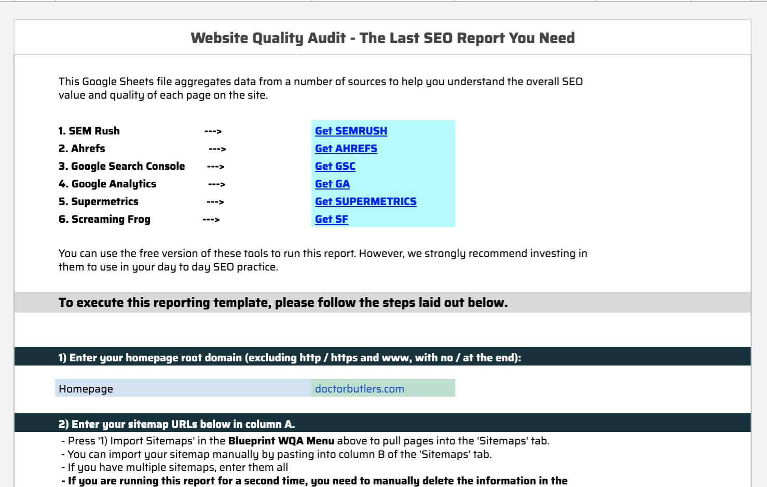
What goes into the “WQA”?
Our team built a tool using API data from 6 vital SEO data sources:
XML sitemaps - to get a list of URLs included in your Sitemap.
Screaming Frog - to get a full list of URLs and files uploaded to your site, page titles, metas, canonical tags and word count per page.
Ahrefs - to get a list of the links pointing to your website and which pages they point to.
SEMRush - to get your current keyword rankings and which pages they correlate to.
Google Analytics - to get sales, leads, and traffic data from search engines only.
Google Search Console - to get SERP impressions and page level click through rates in Google.
Our tool aggregates this data and allows us to assess quality metrics at the page level. From here, we can make a decision about what to do with every page on your site.

Slide 5

What comes out of the “WQA” - Site Sections
Tag | Detail
Product Page | This tag applies to eCommerce websites only. A product page is where they are selling the product (i.e. cart, price, etc).
Product Category | This tag applies to eCommerce websites only. A product category page is where the website lists their products based product type. For example, a website that sells shoes could have category pages for brands like Nike, Reebok, etc. Each of these pages will filter products to show them based on category.
Local Lander | This tag applies to local websites only. A local lander is the dedicated page to a given location. If the business has multiple locations, each store should have it’s own dedicated landing page. If the business only has 1 location, this can apply to the home page.
Lead Generation | This tag applies to pages on a site that are geared towards generating leads. For example, an attorney’s website could be trying to rank for keywords related to the different services they provide (DUI attorney, Criminal defense attorney, etc). Each of these keywords should have a dedicated landing page targeting those keywords.
Blog Post | This tag applies to blog posts. Some sites will have /blog/ or /news/ (or something similar) build into the URL structure.
Blog Category | This tag applies to categories of blog posts. These are generally used on bigger sites that publish a lot of content in order to better organize posts.
Resource / Guide | Similar to a blog post, but more in depth and robust. Resources or guides NOT connected to the blog, but instead are stand alone pages or site sections.
Site Info | This is a broad tag that applies to a wide range of pages. Essentially, these are the required pages to build out a full site but generally have little SEO (i.e. traffic potential) value. This can include about pages, cart pages, terms and services, contact page, shipping, FAQ and more.
After the data is pulled and aggregated, the manual process begins. The first thing we do is group each page into a “section” (see chart for all the section categories we use). We do this for two reasons:
It allows us to segment the site and better prioritize pages / keywords to focus on.
It allows us to compare “apples to apples” (i.e. we don’t want to be comparing an FAQ page to a product page).

Slide 6
What comes out of the “WQA” - URL Actions
URL Action | Detail
1. Leave As Is | No action needed on the page. You can use this tag for pages performing well or for pages you simply want to ignore because they are irrelevant to your SEO (contact page, etc).
2. Update "On Page" | Use this when you want to review the keywords, titles, meta and on page content for that URL. This can also be used for older blog posts / resource guides that you want to update with more recent information.
3. Target w/ Links | If everything checks out with the page but it doesn’t have rankings, the best solution is to target it with links. You can also double up to “Update On Page” and “Target w/ Links” using both action columns.
4. 301 Redirect | When a page serves no value to the website (both for search engines and users) you will want to 301 redirect it into a more relevant page.
5. Canonicalize | If you have similar pages targeting the same topic but you NEED both pages (i.e. you don’t want to remove the page), set a canonical tag that points to the page you want to rank.
6. Block Crawl | If you have a group of pages that serve NO value to search engines (but have value to website visitors), the best option is to block that section from being crawled. This works best when pages are grouped by URL structure (i.e. /archives/).
7. No Index | If you want to stop Google from indexing a low quality page, use this tag. Blocking Crawl is reserved for a number of pages or site sections, No Index is reserved for individual or stand alone pages.
8. Delete (404) | If a page no longer serves a purpose to the website, has NO links, NO traffic and the keywords are no longer relevant, we can delete it.
9. Update Content | If a page is targeting relevant keywords but is too “thin” (less than 500 words) to rank for those keywords, we want to update the content on the page.
After each page on the site is classified into a category, we can quickly assess each page for quality (by section). We assign each page a “URL Action” (see chart to the right for full list and explanations of each). These “URL Actions” dictate:
Which pages to clean up (i.e. redirect, NOINDEX, etc)
Which pages have no potential for traffic and to ignore (i.e. contact page)
Which pages we will focus on for the campaign (i.e. perform KW research, update “on page” elements, target with links).

Slide 7

What are your outcomes?
Important Learnings and Insights:
There are 26 “302” URLs which are temporary redirects.
Are any of these 302’s purposeful? If not, these should be made into permanent 301 redirects, and the URLs should found and replaced with the final URL in the redirect path/chain.
These appear to be .php URL versions of these pages (Ex. https://cibtvisas.com/angola-visa.php instead of https://cibtvisas.com/angola-visa
Multiple Versions of Visa Checks Pages
Google has indexed many duplicate pages on the site, especially local lander pages. Each set of these should be redirected to the newest/best version. Examples: https://cibtvisas.com/destination/bra https://cibtvisas.com/brazil-visa https://cibtvisas.com/destination/bra/brazil-visa https://cibtvisas.com/brazil
Which version is the best version of each page?
Notes:
Full WQA: https://docs.google.com/spreadsheets/d/1Mdr4TEtSKfSqf92sYdIO_6QO-OUw5kcIIApmjCHoArI/edit?gid=1958109987#gid=1958109987

Slide 8
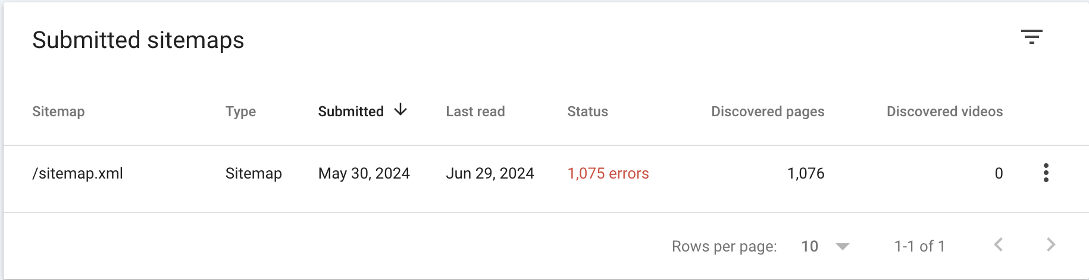
What are your outcomes?
Important Learnings and Insights:
Issues with XML Sitemap
There are several URLs that are not actually listed properly in the sitemap, because there is an empty space found at the beginning and end of the URLs
There are URLs that don’t exist or are redirecting that are in the XML Sitemap - only pages that you want Google to find and index in search should be included in the XML Sitemap
Ex: https://cibtvisas.com/global-immigration-referral
The URLs found in this list are 301 or 302 Redirects, or Broken 404 URLs that should be removed from the XML Sitemap.
Notes:
Full WQA: https://docs.google.com/spreadsheets/d/1Mdr4TEtSKfSqf92sYdIO_6QO-OUw5kcIIApmjCHoArI/edit?gid=1958109987#gid=1958109987

Slide 9
What are your outcomes?
Important Learnings and Insights:
Re-evaluate Page Location
Does it make sense to have the following pages linked on the US site?
https://cibtvisas.com/us-esta
Users click on a URL that then takes them to the US homepage, which also does not serve non-US citizens/site visitors
The following URL https://cibtvisas.com/news-room redirects to the CIBT Weekly Update Page https://cibtvisas.com/weekly-update and is linked in the “News & Updates” card on the text “News Room”
Is this a better alternative location? https://cibtvisas.com/news-and-updates
Notes:
Full WQA: https://docs.google.com/spreadsheets/d/1Mdr4TEtSKfSqf92sYdIO_6QO-OUw5kcIIApmjCHoArI/edit?gid=1958109987#gid=1958109987

Slide 10
What are your outcomes?
Important Learnings and Insights:
Find and Replace
Is there a reason the URL https://cibtvisas.com/fast-track-my-visa.php?source=fast_track_infobox is linked in the “Fast Track my Visa” Card instead of https://cibtvisas.com/fast-track-my-visa? Or that the URL https://cibtvisas.com/visa-pre-check-service.php?source=visa_precheck_infobox is tracked instead of https://cibtvisas.com/visa-pre-check-service?
The purpose appears to be to track when clicks to these pages are brought in by these specific Info Boxes/Cards, but how valuable is this data?
The link authority traveling through the site to these landing pages is reduced due to the use of the URL parameter, and it is preferable to not use this unless absolutely necessary.
Notes:
Full WQA: https://docs.google.com/spreadsheets/d/1Mdr4TEtSKfSqf92sYdIO_6QO-OUw5kcIIApmjCHoArI/edit?gid=1958109987#gid=1958109987

Slide 11
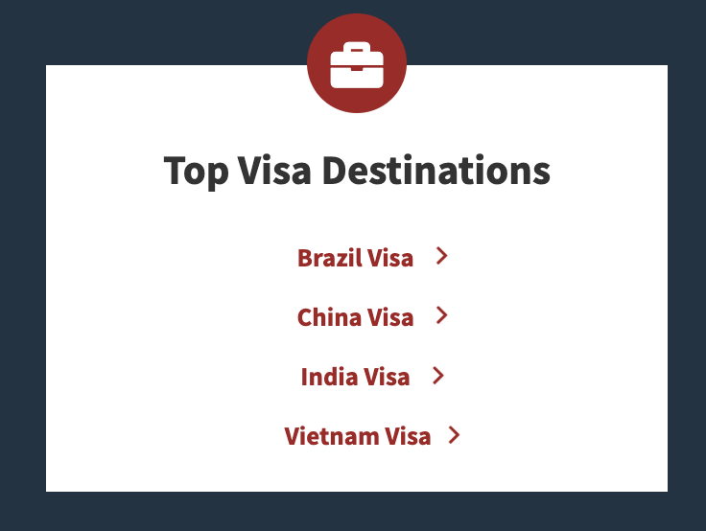
What are your outcomes?
Important Learnings and Insights:
Pages Blocked by Robots.txt
Why are the pages with the rows highlighted in the following sheet linked here currently blocked by robots.txt?
Duplicate Sample Visa Pages
Duplicate instance of “Sample Visa” pages were identified. For example, the following URL https://cibtvisas.com/sample-visas/BRA/brazil.php has several duplicates, which are the following:
https://cibtvisas.com/sample-visas/BRA/china-visa
https://cibtvisas.com/sample-visas/BRA/india-visa
https://cibtvisas.com/sample-visas/BRA/vietnam-visa
In the example above, all of these URLs provide information on a Sample Brazil Visa
The generation of these URLs is due to their link location in the “Top Visa Destinations” card on the page.
Notes:
Full WQA: https://docs.google.com/spreadsheets/d/1Mdr4TEtSKfSqf92sYdIO_6QO-OUw5kcIIApmjCHoArI/edit?gid=1958109987#gid=1958109987

Slide 12
What are your outcomes?
Important Learnings and Insights:
Duplicate Sample Visa Pages
When visiting the page https://cibtvisas.com/sample-visas/SAU/, users from Saudi Arabia may be looking for a visa to visit another location.
When clicking on “China Visa” under “Top Visa Destinations”, users are taken to the following page https://cibtvisas.com/sample-visas/SAU/china-visa, which contains the same Saudi Arabia Sample Visa
Does the current user experience here make sense?
302 URLs Found on Sample Visa Pages on “Get a Visa” Link
When selecting a "Destination" from the dropdown filter under the text "To see a sample travel visa..." on pages such as https://cibtvisas.com/sample-visas and https://cibtvisas.com/sample-visas/CHN/china.php, the URL found linked on the text “Get a Visa” that appears each time the dropdown is changed links to a different 302 Redirect URL.
Ex. When visiting https://cibtvisas.com/sample-visas/CHN/china.php, clicking the dropdown for “Indonesia” places https://cibtvisas.com/indonesia-visa.php as the link on “Get a Visa”.
Action Item: Replace all instances of these 302 URLs with their 200 Status counterpart. Locations for each of these URLs can be found in this sheet linked here.
Notes:
Full WQA: https://docs.google.com/spreadsheets/d/1Mdr4TEtSKfSqf92sYdIO_6QO-OUw5kcIIApmjCHoArI/edit?gid=1958109987#gid=1958109987

Slide 13
What’s next?
Recommended Action Items:
Create an updated XML Sitemap that:
Only includes 200 Status Pages (Remove all other URLs without this status)
Remove spaces from the beginning and end of all URLs
Remove Duplicated Content, Where Applicable
Sample Visa Pages
Determine & Confirm Main Version of each Destination Sample Visa URL
Ideal Action: Canonica
Alternative Actino: Add a canonical tag to all other instances of the sample visa URL for the same destination, to canonicalize to that identified main Destination Sample VIsa URL.
Visa Check Pages
After determining which version of the visa check pages is the main one, have all other instances redirect to the main URL, and replace all internal locations of the Old URLs, with the new URLs
Notes:
Full WQA: https://docs.google.com/spreadsheets/d/1Mdr4TEtSKfSqf92sYdIO_6QO-OUw5kcIIApmjCHoArI/edit?gid=1958109987#gid=1958109987

Slide 14

THANK YOU!
www.propellic.com

